Slide 1
Architectural Style Classification using Semantic Segmentation
CSE 496 - Third Presentation
Emirkan Burak Yılmaz
Project Supervisors:
Prof. Dr. Yusuf Sinan Akgül
12/06/2024

Slide 2
Contents
Model Architecture
Combined Model Architecture
Train & Evaluate: U-Net
Train & Evaluate: arch-top
Train & Evaluate: arch-all
Grad-CAM Heatmap
Style Clustering
Success Criteria
References

Slide 3
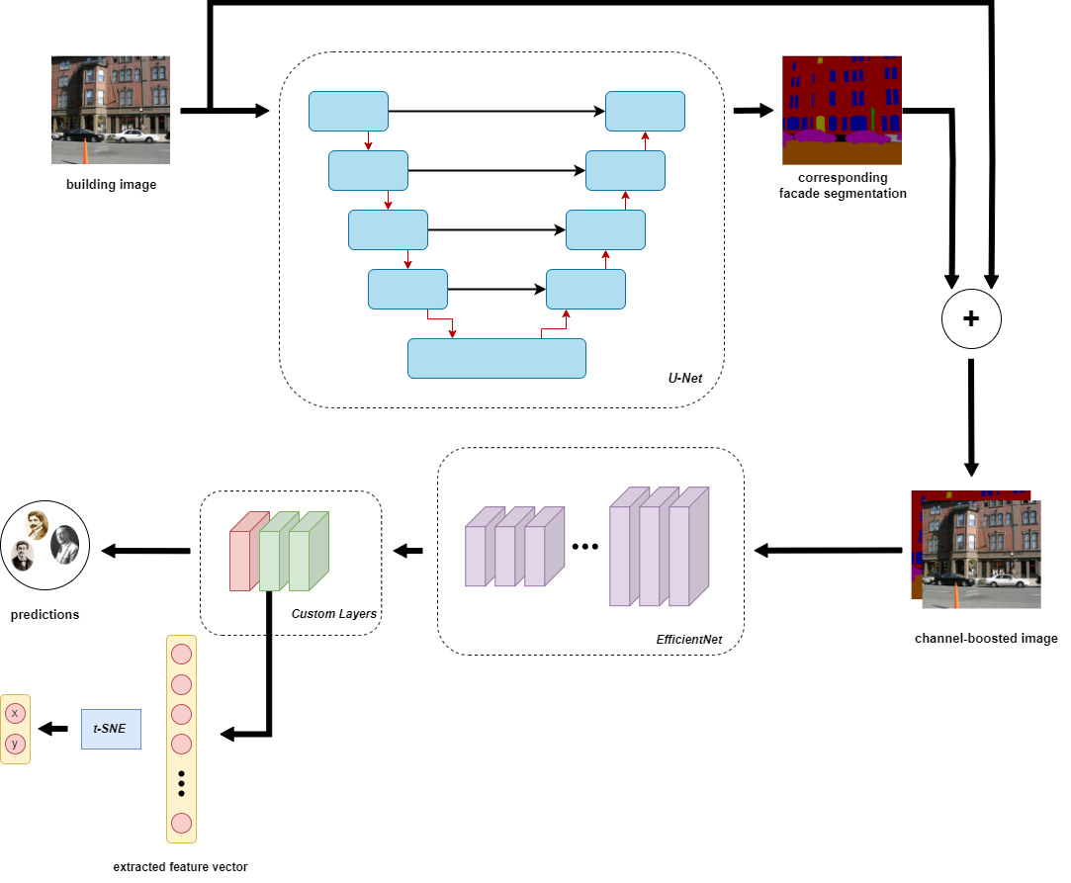
Model Architecture
Notes:
per-pixel semantic labeling of the image without considering higher-level object instance or boundary information.
The skip connection are included to combine low-level features with high-level features

Slide 4
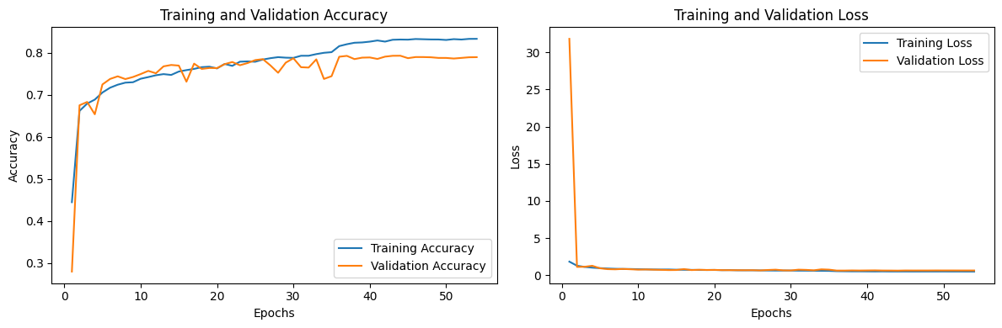
Train & Evaluate: U-Net
Accuracy: 0.7900
Precision: 0.8276
Recall: 0.7578
Notes:
Where is the windows

Slide 5
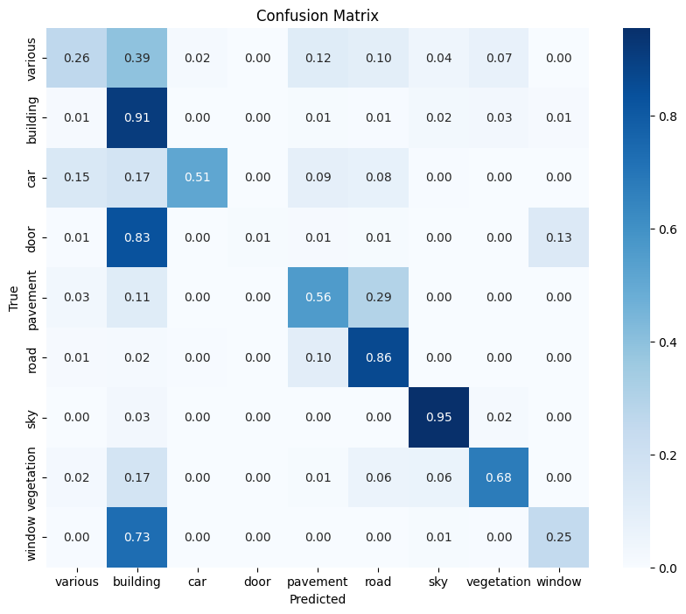
Confusion Matrix
Notes:
Where is the windows

Slide 6
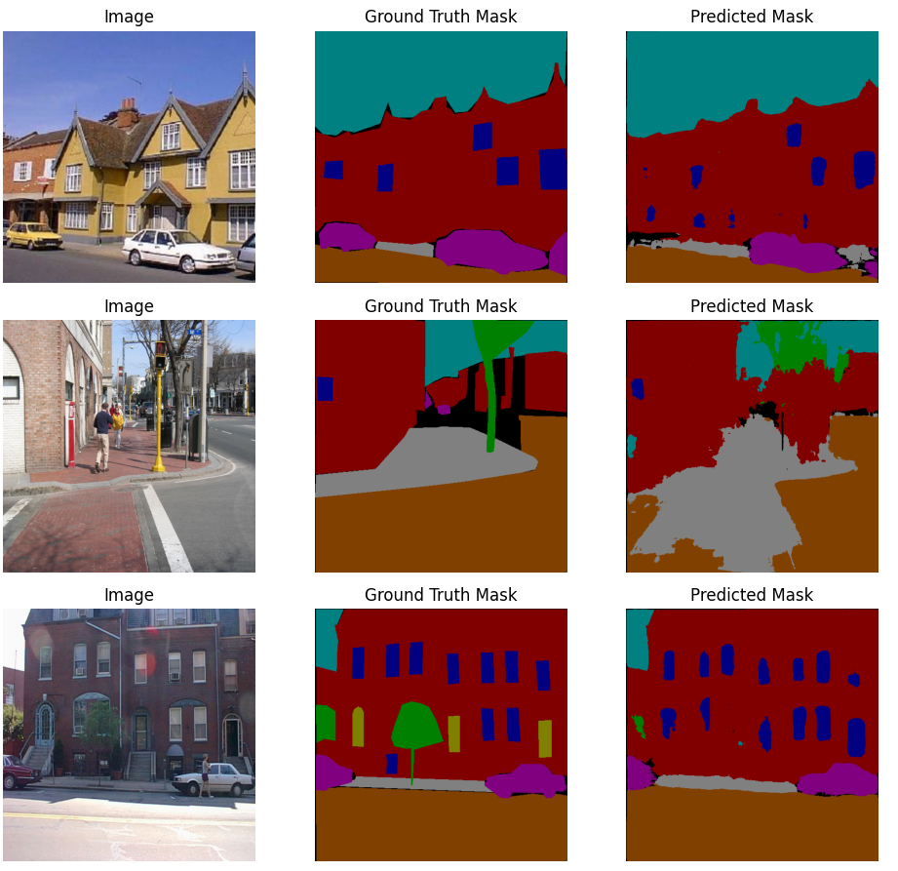
U-Net Predictions
Notes:
Where is the windows

Slide 7
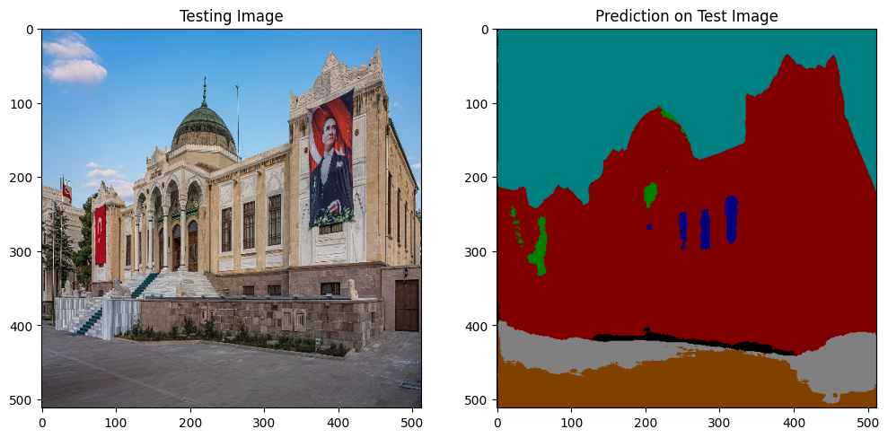
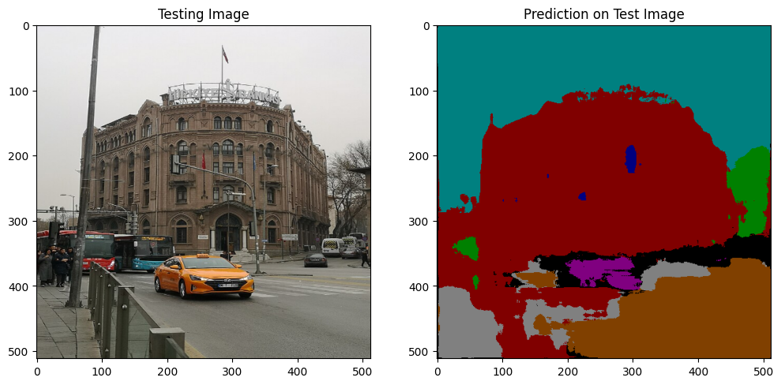
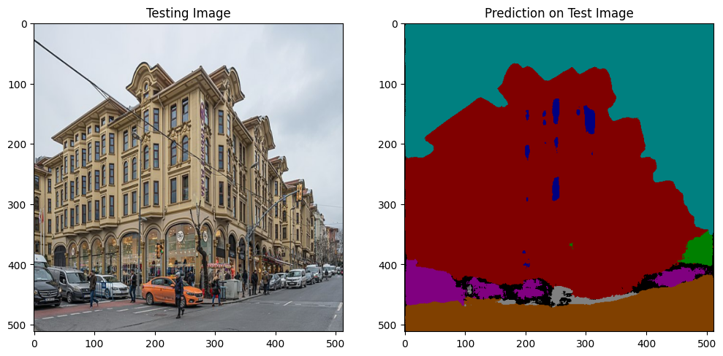
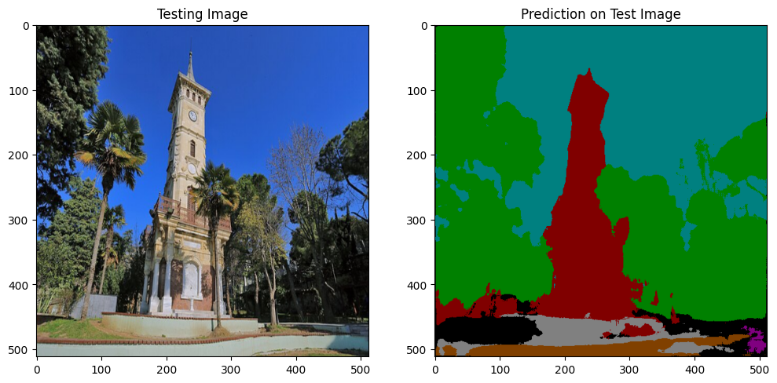
U-Net Predictions

Slide 8
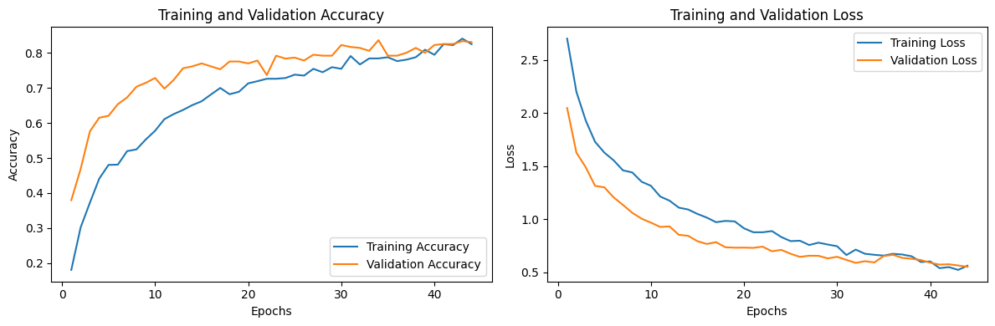
Train & Evaluate: arc-top
Accuracy: 0.9039
Precision: 0.8626
Recall: 0.8465

Slide 9
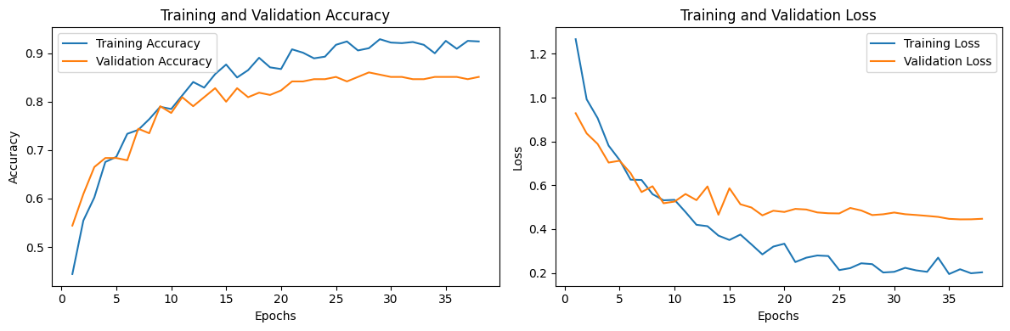
Train & Evaluate: arc-all
Accuracy: 0.9693
Precision: 0.8918
Recall: 0.7535

Slide 10
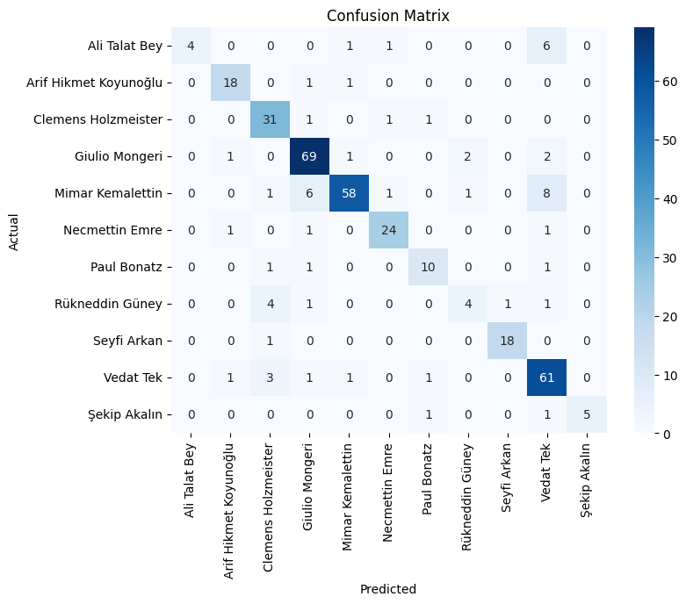
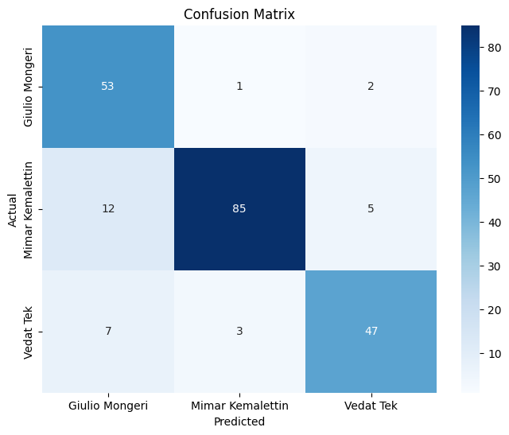
Confusion Matrices
arch-top
arch-all
Notes:
Where is the windows

Slide 11
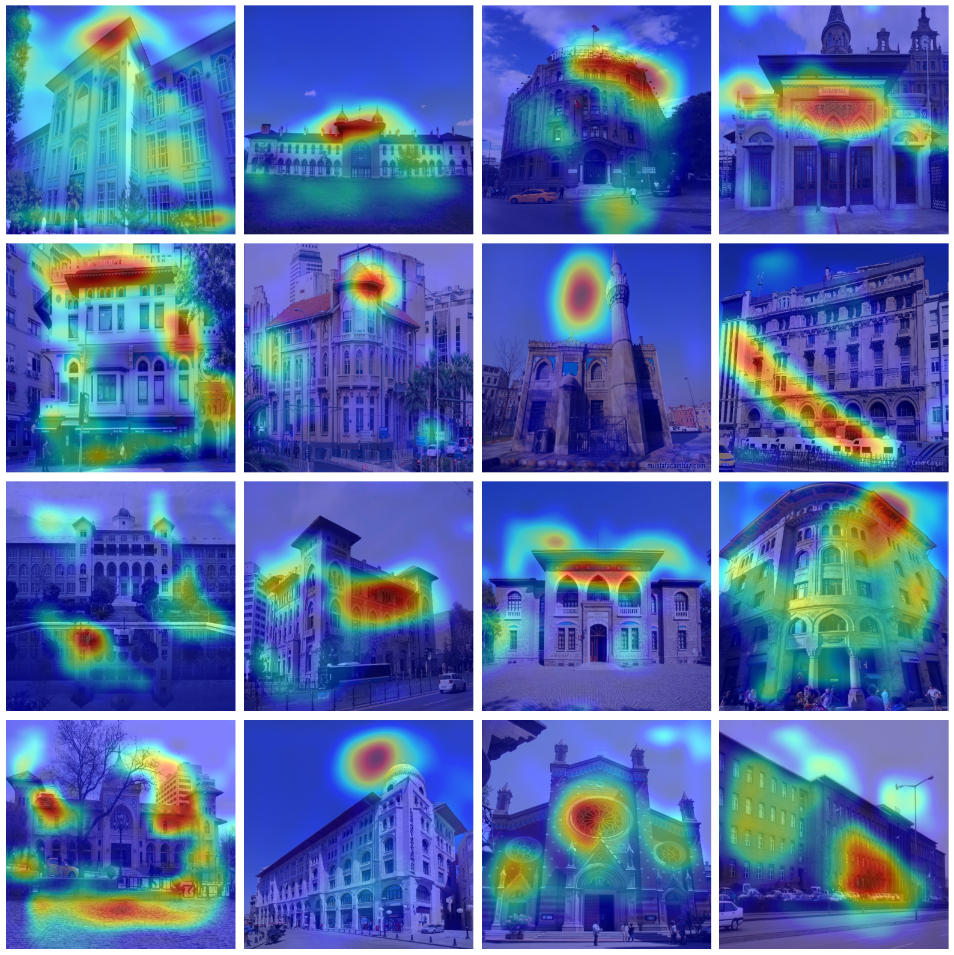
Grad-CAM Heatmap
arch-top

Slide 12
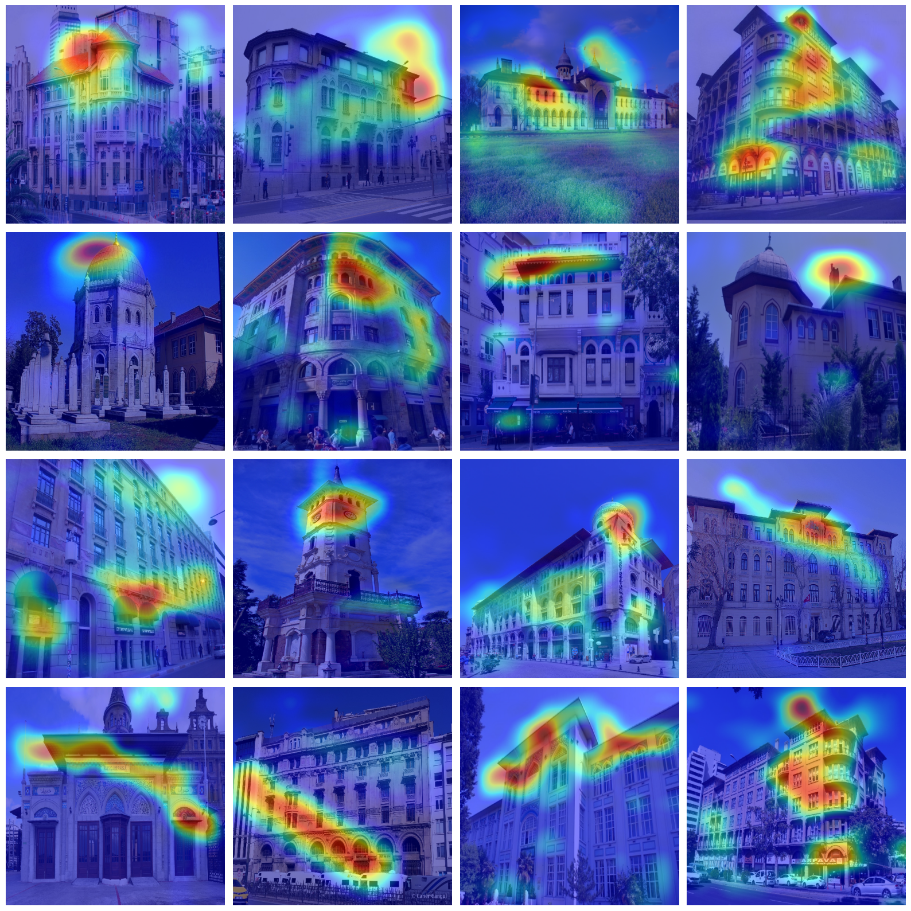
Grad-CAM Heatmap
arch-all

Slide 13
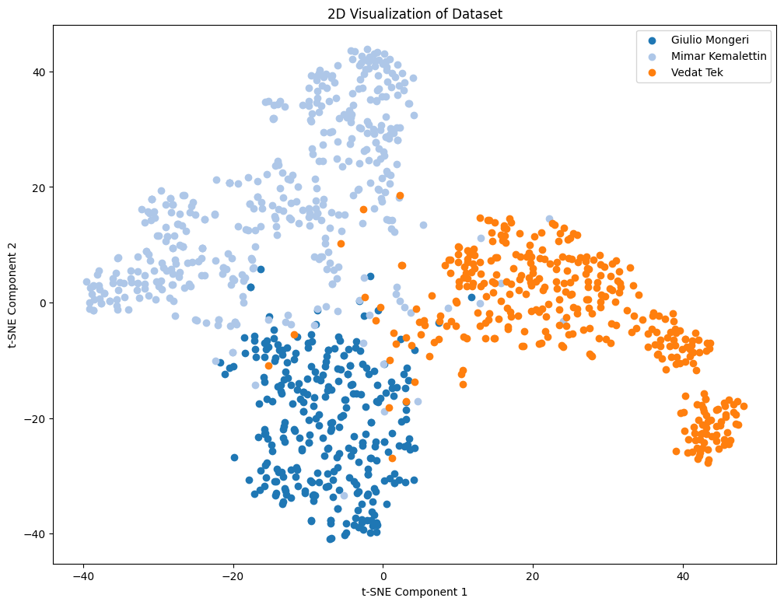
Style Clustering
arch-top

Slide 14
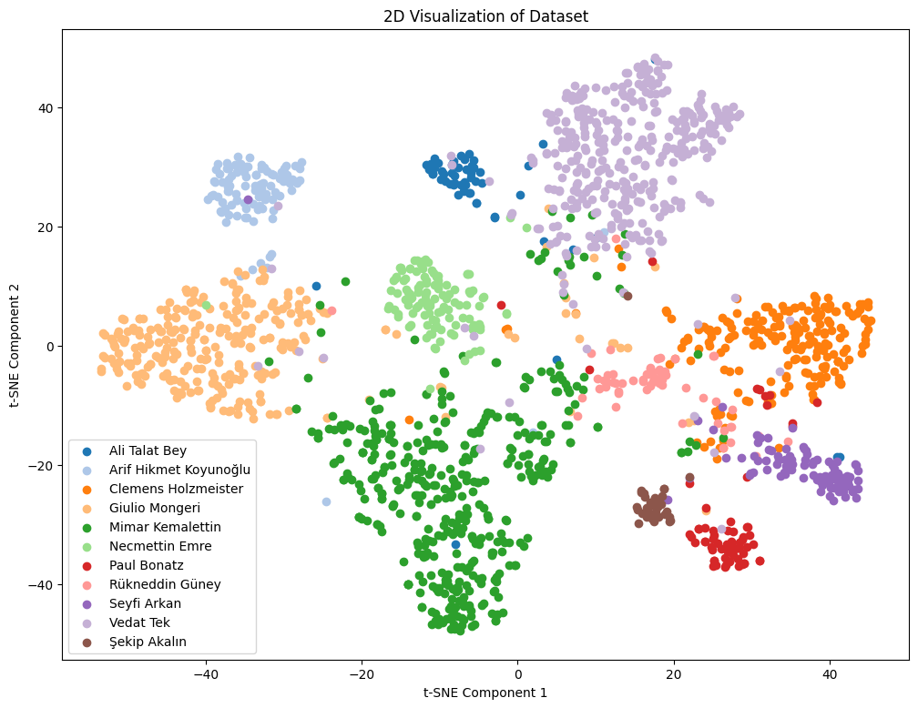
Style Clustering
arch-all

Slide 15
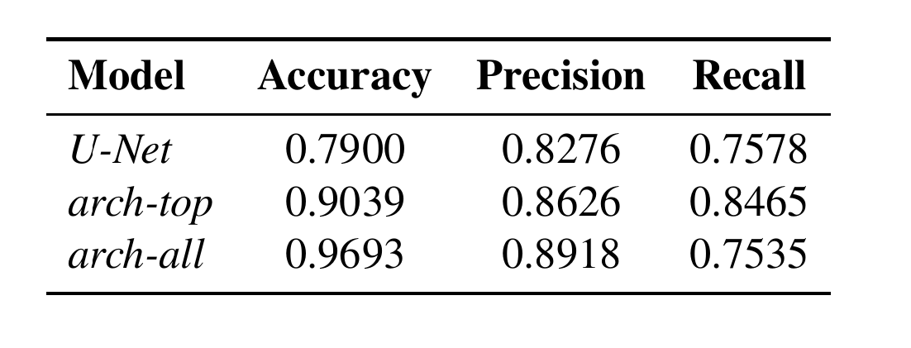
Success Criteria
80% accuracy on semantic segmentation
90% accuracy for 3 architects (prev. 84%)
80% accuracy for 11 architects (prev. %73)

Slide 16
References
Yoshimura, Y., Cai, B., Wang, Z. and Ratti, C., 2019. Deep learning architect: Classification for architectural design through the eye of artificial intelligence. Computational Urban Planning and Management for Smart Cities 16, pp.249-265.
Zhang, M., Cui, Z., Neumann, M. and Chen, Y., 2018, April. An end-to-end deep learning architecture for graph classification. In Proceedings of the AAAI conference on artificial intelligence (Vol. 32, No. 1).
Pesto, C., 2017. Classifying US Houses by Architectural Style Using Convolutional Neural Networks.
Wang, B., Zhang, S., Zhang, J. and Cai, Z., 2023. Architectural style classification based on CNN and channel–spatial attention. Signal, Image and Video Processing, 17(1), pp.99-107.
Architecture of Turkey: https://en.wikipedia.org/wiki/Architecture_of_Turkey
İcons: Flaticon.com

